Slide 1

Wabtec i360 Metrics

Slide 2
Definition/Purpose:
To capture the metrics of i360 web app so that we can track and compare performance of the web application. The metrics include CPU utilization, Memory utilization and Load average of both CPU and memory.

Slide 3
Steps to capture metrics:
Step1: Open Datadog URL
ttps://wabtec.datadoghq.com/dashboard/8za-2xh-29g/enterprise-cloud-teamss-landing-page?from_ts=1624503944695&to_ts=1624507544695&live=true

Slide 4
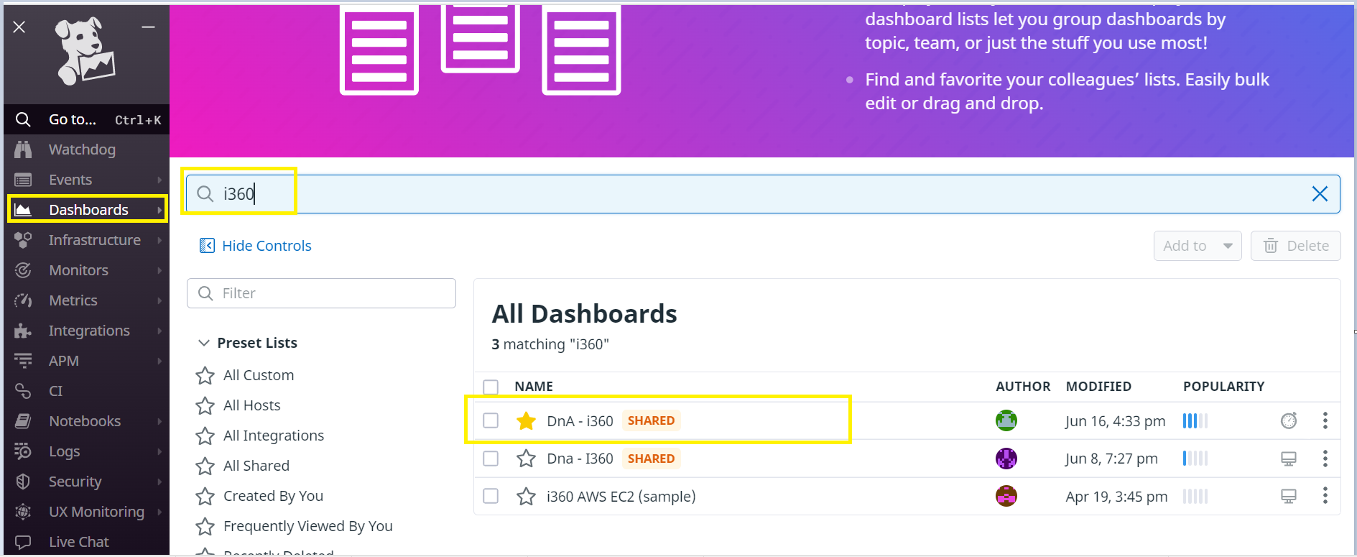
Step2: Open Dashboard section
Once you have opened above URL, on the left side there is a Menu page where you can find various services provided by Datadog. Click on the Dashboards title and Search for i360. Select "Dna- i360" dashboard

Slide 5
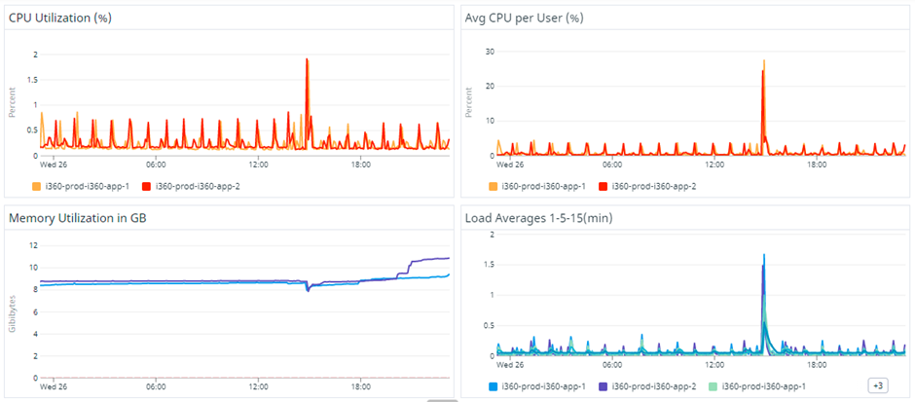
Step4: Capture the server status
Open the above dashboard and scroll down until you observe Server Monitoring and Capture the whole metrics as below screenshot

Slide 6
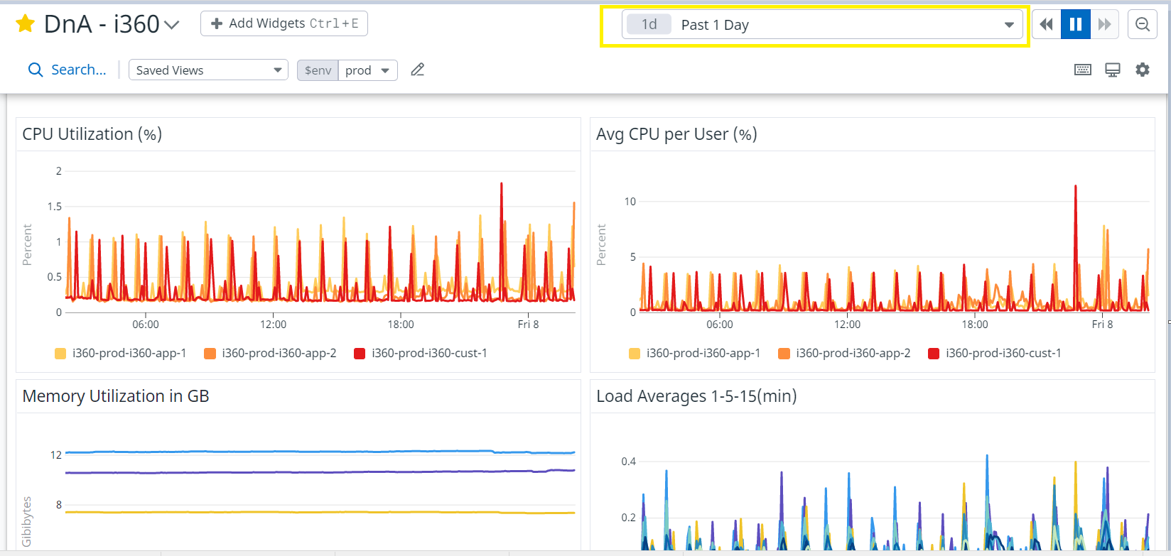
Note: Make sure once you open the i360 dashboard, on the top of right side check the timeline as past 1 day or last 24 hrs as above screenshot.
Finally, We should send an email to client in between 5am IST to 6am IST Daily

Slide 7
Thank You

